Slide 1
DEVLOPMENT
OF
US
Day by
day

Slide 2
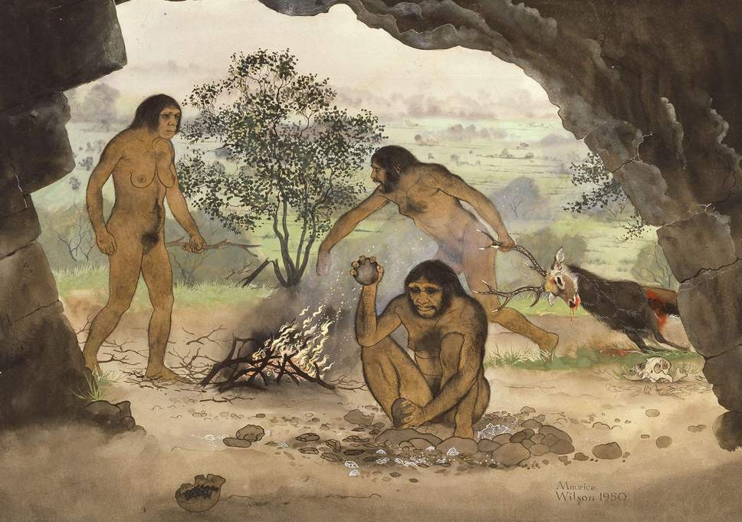

Slide 3


Slide 4
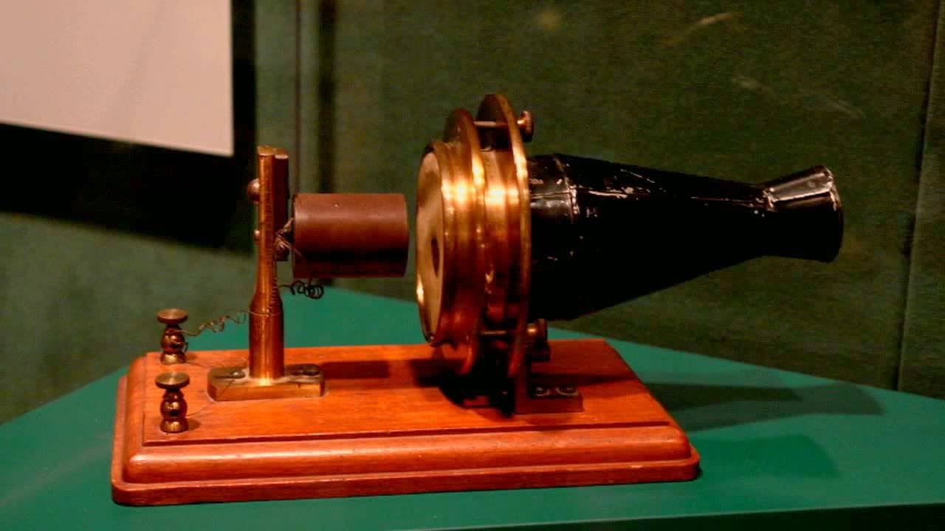
1876

Slide 5


Slide 6
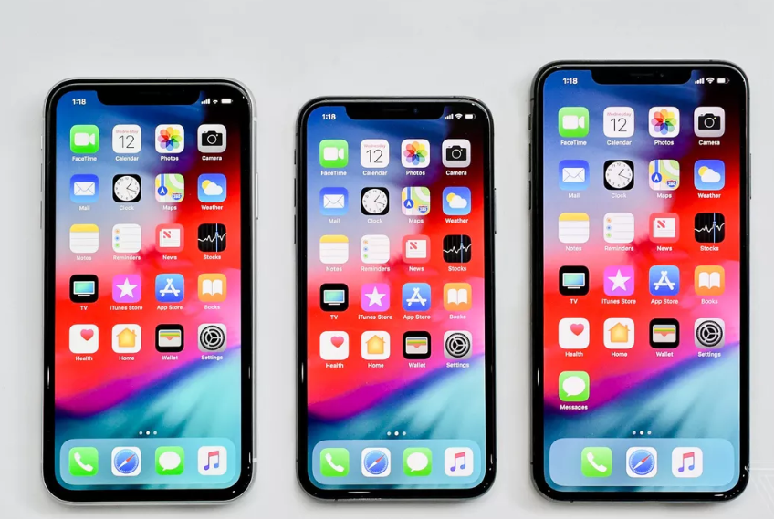

Slide 7
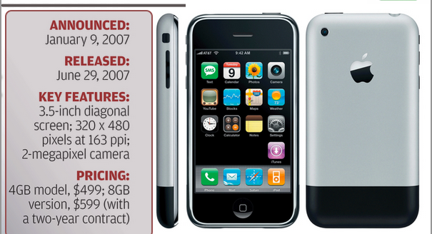

Slide 8
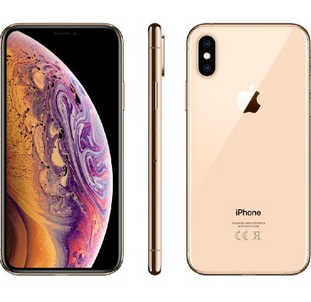

Slide 9
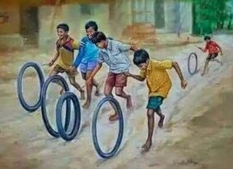

Slide 10


Slide 11


LOVERS

Slide 12

MADE AND
DESIGNED BY:-
RACHIT GARG

